Slide 1


Case: Predicting Consumer Tastes with Big Data at Gap - The Art and Science of Fashion
Team 6
Avishek Dasgupta
Roshan Raj Singh
Sai Mona Duvvapu
Sohan Kumar Sahoo

Slide 2




Business Problem
Can machine intelligence rule over human creativity in the fashion designing process?

Slide 3
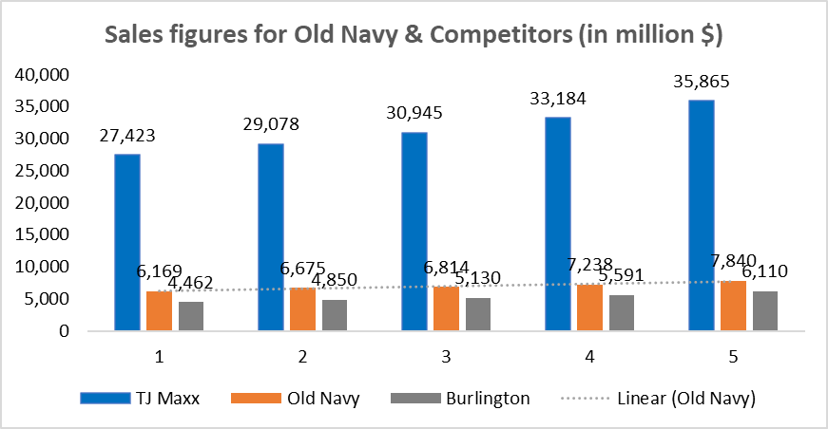
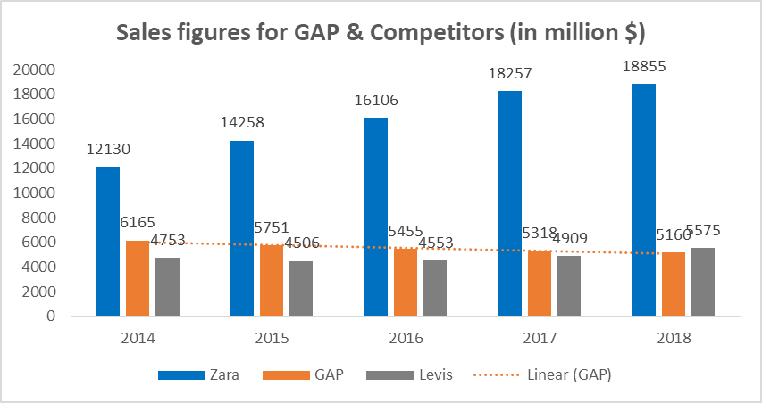
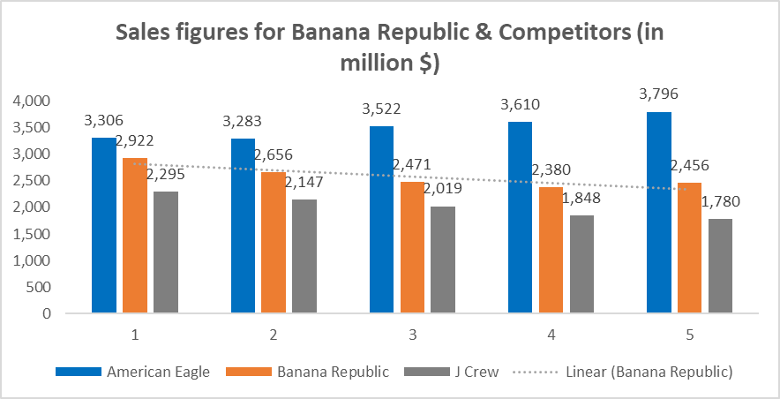
Was Peck Right?
Sales Figure Analysis
1
Old Navy's sales grew between 2014 and 2018, but its direct competitors grew faster
2
Gap's and Banana Republic's sales continued to decline, but it was an industry-wide trend
3
Only a few competitors, such as Zara and American Eagle, showed signs of success
Limitation: Revenue is dependent on multiple factors and not just big data.

Slide 4
Our Approach
Understand the internal/external data available to Gap.
Build a methodology to predict fashion trends
Insights that can be drawn from such data
How big data can help individual brands
Data-backed inferences on whether big data was a good way forward for all 3 companies
Inferences on creative designer vs big data

Slide 5

Data-Driven Creative Process At GAP
Data model should give us insights on:
01
Design of product: color, fit type, pattern, fabric composition, silhouette
New product launch time
02
03
New Product Launch Locations
Quantity and Price range for the targeted customer segment
04

Slide 6

Data to build predictive model
In- House Data
External Data
Competitor Prices & New Offerings
@
Website Visits, Wish-Lists
Fashion week/Catwalks Image Analysis
SKUs sold via Online/offline
E-Commerce Bestsellers
Time from Shelf to POS
Google Trends
Review & Sentiment Analysis
Social Media
Online/ Offline Surveys
Social Events

Slide 7
Competitor Analysis
Zara vs. GAP
1
Hypothesis: Mean of the prices of the product from Zara and Gap are different​ for Jeans
t-Test: Two-Sample
 | Zara | GAP
Mean | 62.10 | 69.74
Variance | 293.73 | 72.10
Observations | 10.00 | 36.00
Hypothesized Mean Difference | 0
P(T<=t) two-tail | 0.20
2
Run t test to determine if diff in mean prices are statistically significant
3
GAP's jeans sample mean= $69.06
4
Zara's jeans sample mean= $62.1
5
From t test results we can infer that difference in mean of prices on offer across GAP and Zara statistically insignificant
6
As Zara and Gap have similar prices, we can extract design patterns 0f Zara's new offerings and use that data to design new products for GAP

Slide 8
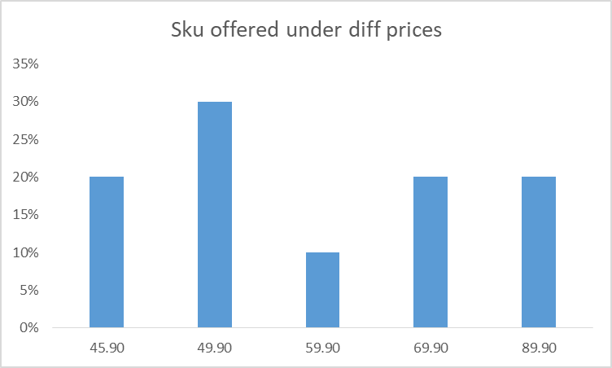
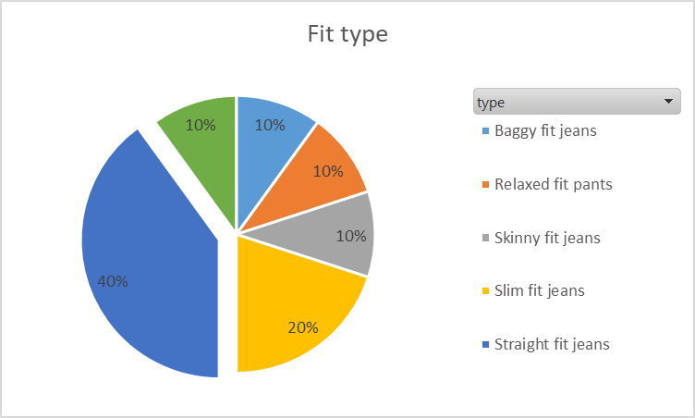
Insights on Zara’s New Offerings
1
Analysis of its new product offers gives us valuable insight into price, fabric, fit type and color
2
Zara has forecasted baggy jeans to be the norm
3
Offering products across entire price range, giving sense that demand to remain same across segments
4
Under the hypothesis that Zara has finest predictive model, directly copying the trends in new offerings can really work for brands GAP and Old Navy

Slide 9
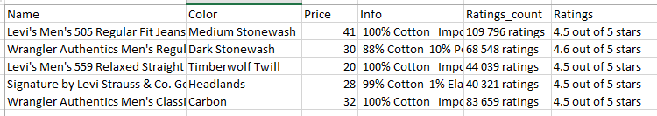
Amazon’s Bestsellers
1
Amazon lists out its best sellers with rankings and associated details of product
2
Data can be utilized in finding the relation of the rank(dependent variable) with other variables such as price, fabric, color etc specific to fashion industry
3
This data can be used to build an inferential model
Below is a sample collected from Amazon best seller website
Inferential Model:
Rank= C + B1*Color + B2*Price + B3*Color*Price + B4*Material composition + B5* Brand image/value + B6*Brand image*Price
Interaction term of color*price takes into consideration that certain colors demand a small premium from other colors and similar is with brand image*price, certain brands enjoy premium based on popularity

Slide 10
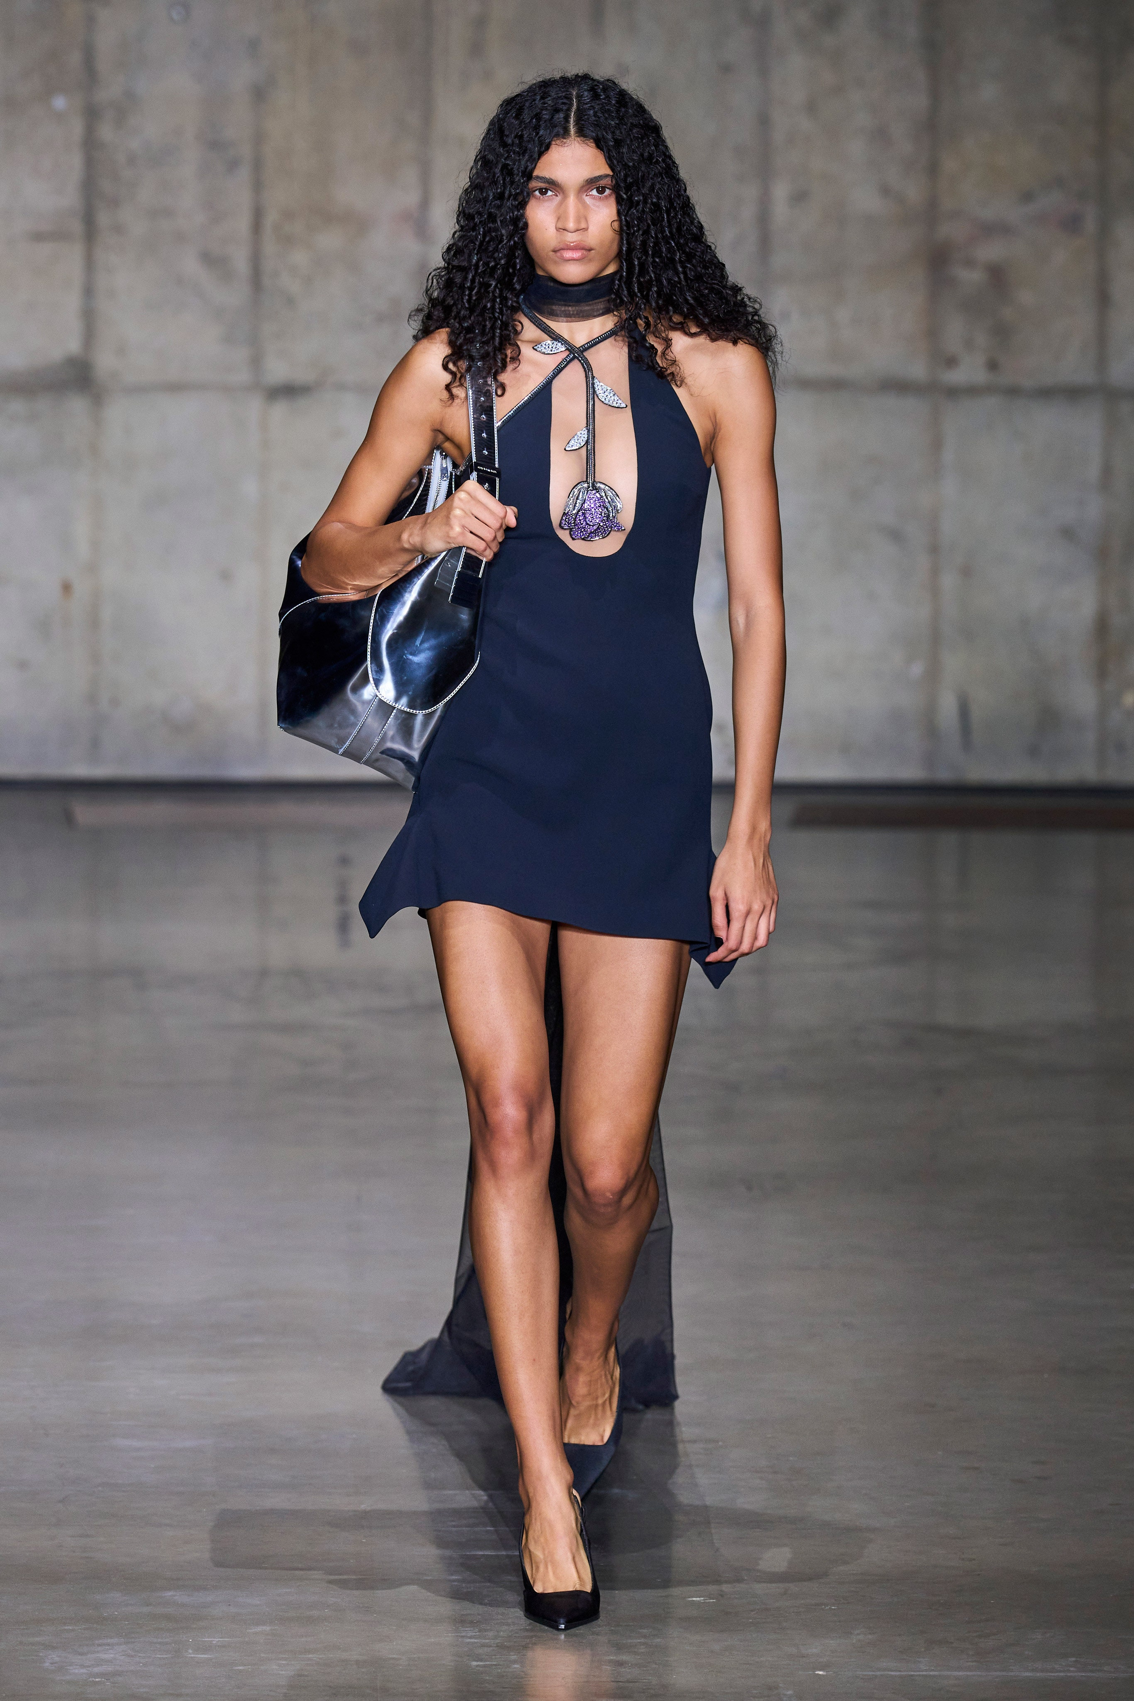
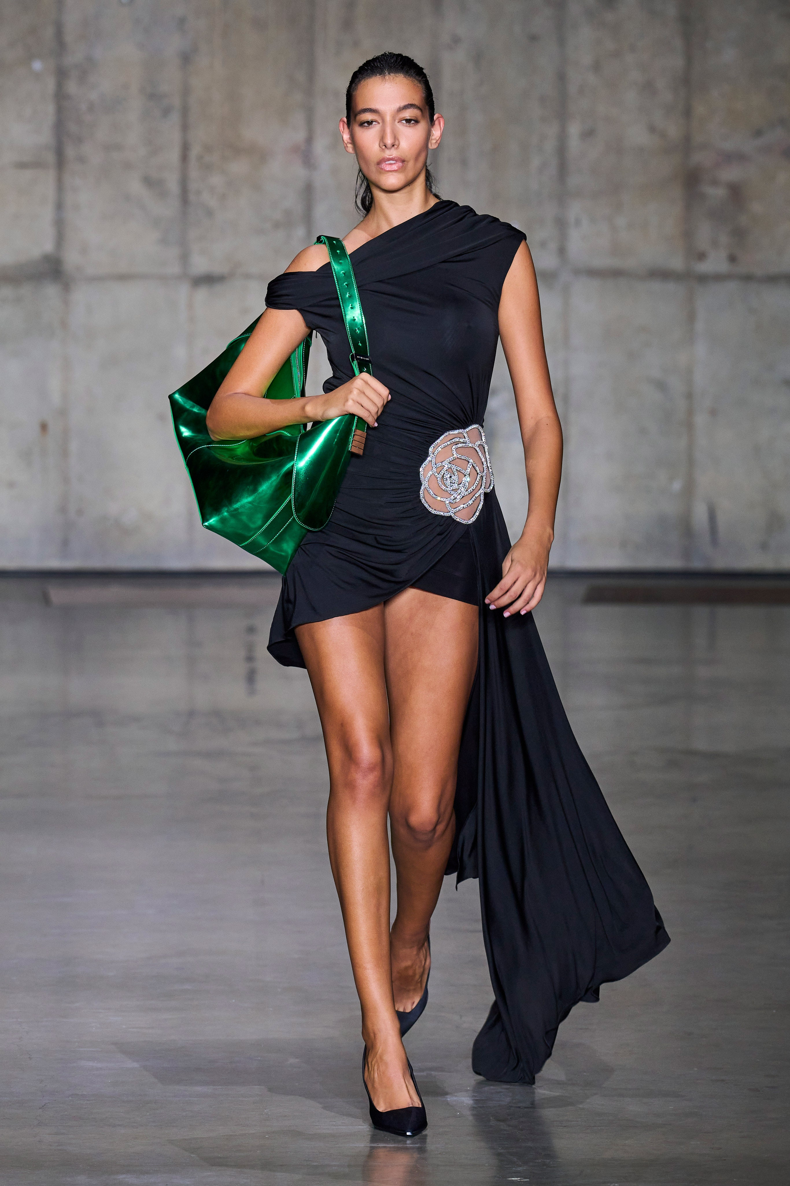
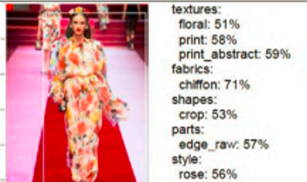
Fashion Week/Catwalk Image Analysis
Images scraped from Vogue
1
Images can be collected from weekly or monthly fashion week and catwalks
2
Image recognition technology can be incorporated to identify the fabrics, pattern, fit and color from these images
3
Secondary validation of the analysis can be done from designers
4
Methodology can be applied to social media platforms like Instagram, whereby outfits of influencers can be tracked

Slide 11
GAP Website & Store Level Data
@
Website Visits, Wish-Lists
1
Present sales information gives insights into customer preferences and current inventory
SKUs sold via Online/offline
2
Stockouts and markdown information give us performance of products
Time from Shelf to POS
3
Surveys and reviews collected at stores gives us valuable sense of customer's fashion sense and needs
Store Manager Feedback
4
Allows efficient management of sourcing and stocking merchandise
Online/ Offline Surveys

Slide 12
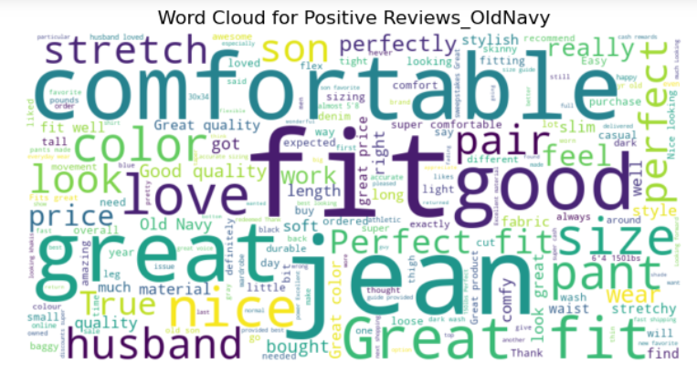
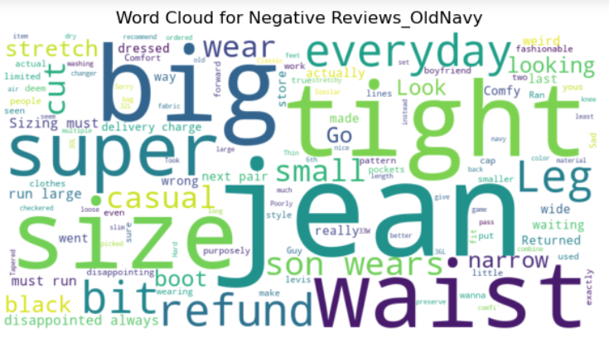
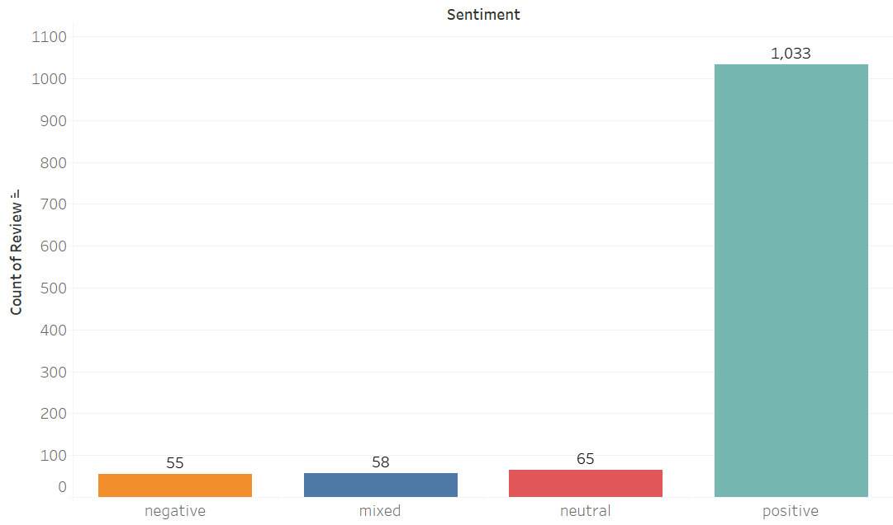
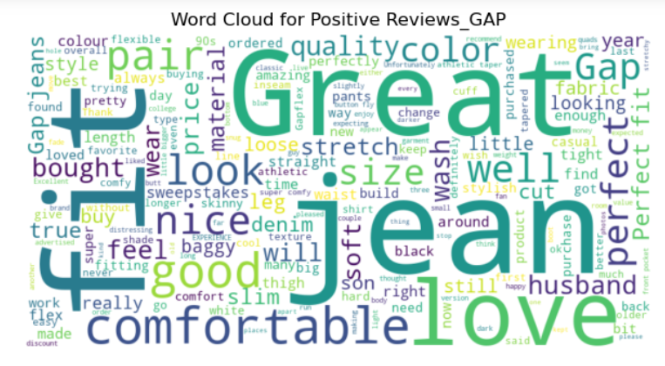
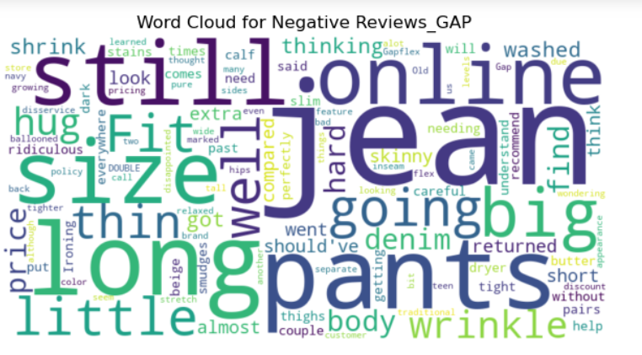
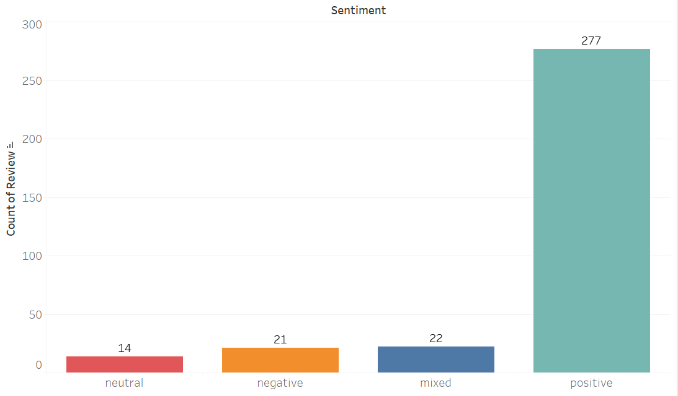
Review & Sentiment Analysis

Slide 13
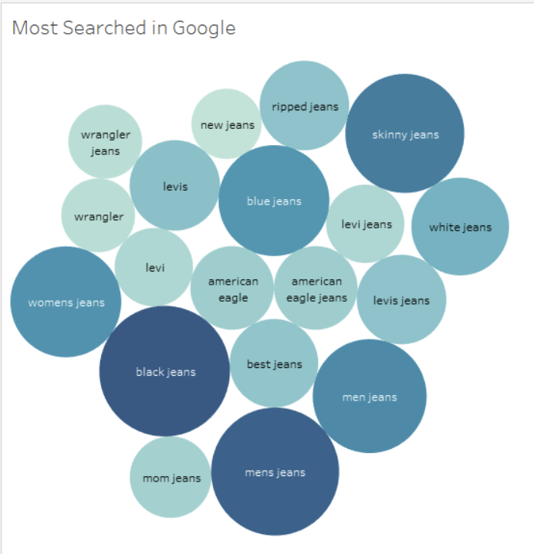
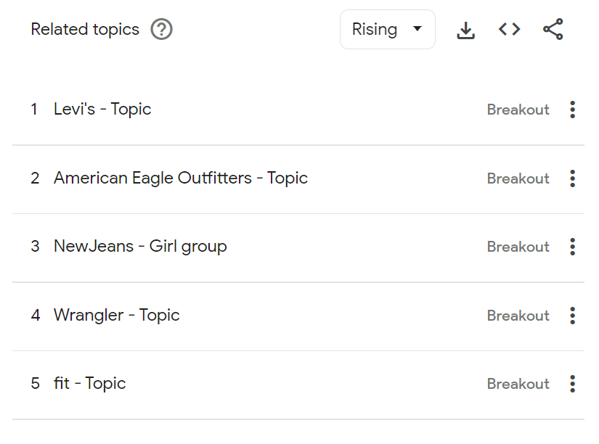
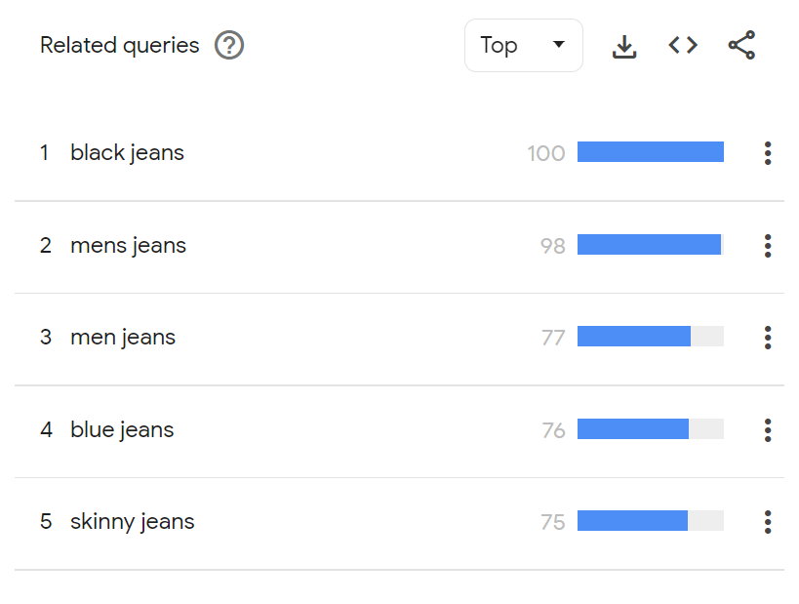
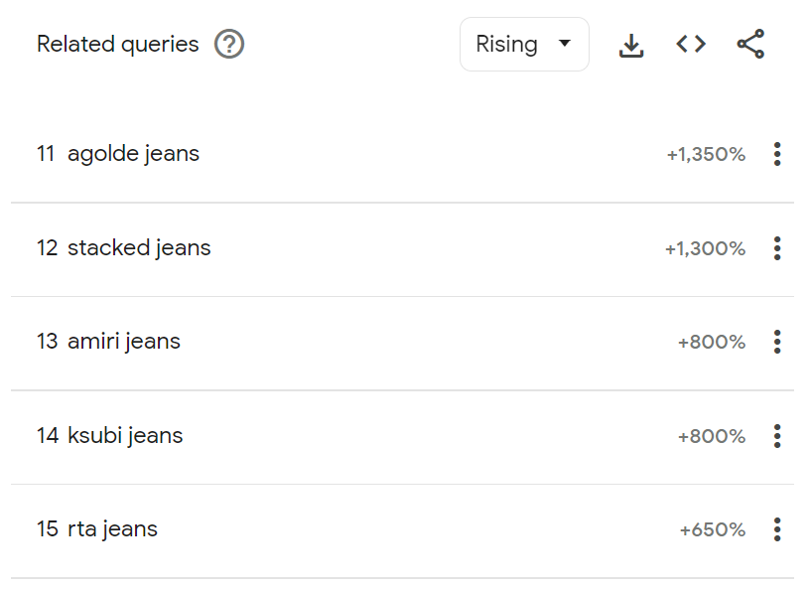
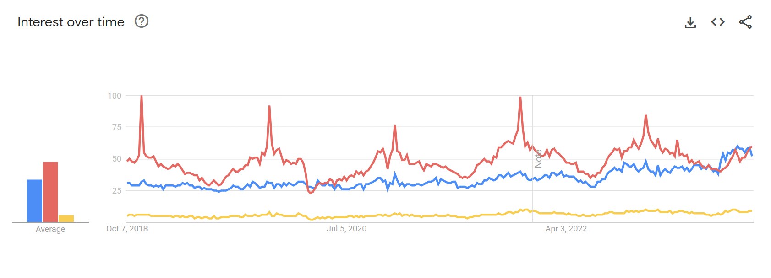
Google Trends
Gives insights on rising, trending queries related to a search term. For our chosen product "Jeans", it revealed trending styles, colors and brands that people are searching

Slide 14
Brand Positioning
Budget conscious shoppers' choice
More affordable than Gap
Constitutes mainstream fashion
Consistent promotions & sales to attract more customers
Casual, every-day clothing
Constitutes trendy fashion
Affordable – mid-range pricing (higher than Old Navy but cheaper than Banana Republic
Exclusive and premium brand of Gap Inc.
Constitutes edgy and classic fashion
Emphasis on quality, style and exclusivity

Slide 15
Only Big Data: Right Approach?
Old Navy
GAP
Banana
Republic
In-house and external data availability
Complexity in design
High customer expectation
With limited and exclusive collection with prolonged sales cycle, availability of in-house data for Banana Republic is a concern
Have to rely heavily on external data from fashion magazines, catwalk images, detection of cultural shift
Level of complexity in production and fabric composition makes it much more difficult to predict
Customer expectations of this niche segment is higher in terms of design, exclusivity, personal experience
High opportunity cost: Loss of customer's loyalty, switching of brands, loss of production time, loss of higher quality fabrics from unsold products

Slide 16
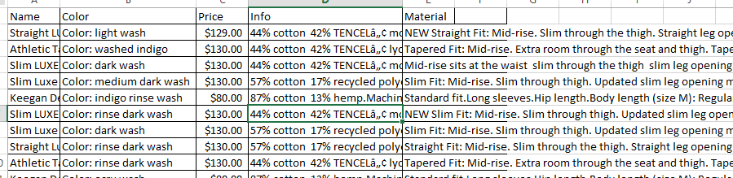
Fabric & Material Complexity: Banana Republic
Type of color is not regular which is found in other brands but are blended
Different composition of fabrics
Complexity involved here will be difficult for any data model to predict

Slide 17
Data Limitations
Data available from Zara new collection is limited, t-test on sample applied for comparing mean of prices against GAP
Unavailability of store level and online sales, reviews data points for finding correlation between demand against product variables like price, color, pattern, fabric, silhouette.
Amazon's best-selling data scraped is across the entire product category but not specific to any particular customer segment.

Slide 18
Big Data in Marketing
Price
Product
Science more useful
Identifying market opportunities
Tracking customer journey in the product and identifying drop off pages
Art more useful
New Product Development
Designing and enhancing user experience
Packaging
Science more useful
Tracking competitor prices
Building a dynamic pricing model taking demand into consideration
Art more useful
Developing value based pricing strategy by identifying customer's perception of value
Place
Promotion
Science more useful
Online vs offline presence
Identifying right place for right product
Art more useful
Store design
Enhancing in-store experience
Science more useful
Targeted Advertising
Content Personalization
Measuring Campaign Effectiveness
Art more useful
Branding
Advertising and Creative Campaigns
Content Creation

Slide 19
Recommendations
Visibility and creating brand image with respect to the audience a company is catering to. For example, Banana Republic should prioritize being part of high-end fashion shows to associate with such kind of customers.
Employ a creative director for:
data validation of output of the training data set before being used in predictive m0del
enhancing brand image by employing reputed designers, higher segment customers expect clothes to be designed by designers rather than machines

Slide 20
New Big-Data + Creative-led Model
Google Analytics
In-store Data
Social Media, Google Trends
Competitive Analysis
Predictive Models
Role of Creative-leads:
Validate the output of training dataset.
Trend Spotting
Sales Analysis
Role of Creative-leads:
Evaluate the predictions in relation to social and economic settings.
Fashion Predictions
Colors
materials
styles
shapes
Lower-level Designers + Merchants
Role of Creative-leads:
Customers expect designers to design rather than machines especially luxury products
Full line Development:
Product Assortment
Price + Quantity

Slide 21
Thank You

